Slide 1


Introduction to Testing
| DevOps and Cloud Computing

Slide 2

Objective
Understand the importance of software testing and different testing types.
Explore popular unit testing frameworks like JUnit, pytest, RSpec, and Jest.
Learn how to choose the right testing framework for a project.
Write unit tests using a selected testing framework.

Slide 3
Explain why testing is essential for software quality and stability
| DevOps and Cloud Computing

Slide 4
Testing
Software testing is essential for ensuring software quality and stability because it identifies defects, enhances performance, and ensures compliance with requirements before a product reaches end users. Key reasons include:
Defect Identification and Risk Mitigation
Improved Quality and Reliability
Customer Satisfaction
Cost Savings
Security Assurance

Slide 5
Pop Quiz
Q. What is the primary purpose of software testing?
A
B
To identify and fix defects early in development
To write code faster

Slide 6
Pop Quiz
Q. What is the primary purpose of software testing?
A
B
To identify and fix defects early in development
To write code faster

Slide 7
Discuss different types of testing
| DevOps and Cloud Computing

Slide 8
Let’s discuss
Software testing involves various types, each serving a specific purpose in ensuring software quality. Below are the key types discussed:
Unit Testing: Focuses on testing individual components, functions, or modules in isolation to ensure they work as intended. It is typically automated and performed early in development to catch bugs at the source level.
Integration Testing: Ensures that different modules or components of the software interact correctly. This type of testing identifies issues in the integration points, such as database connections or API interactions.
Regression Testing: Verifies that new changes or updates do not negatively impact existing functionality. It is crucial for maintaining software stability after modifications or bug fixes

Slide 9
Introduce popular unit testing frameworks across different languages
| DevOps and Cloud Computing

Slide 10
Unit testing
Here are popular unit testing frameworks across different programming languages:
JUnit (Java): A widely-used framework for Java, JUnit supports test-driven development (TDD) and simplifies creating and running repeatable tests.
pytest (Python): Known for its simplicity and flexibility, pytest is a powerful Python testing framework.
RSpec (Ruby): RSpec is a behavior-driven development (BDD) framework for Ruby. It emphasizes human-readable test descriptions and is highly popular for writing expressive and maintainable test cases in Ruby projects.
Jest (JavaScript): Developed by Facebook, Jest is a JavaScript testing framework optimized for React applications.

Slide 11
Comparing key features
| DevOps and Cloud Computing

Slide 12
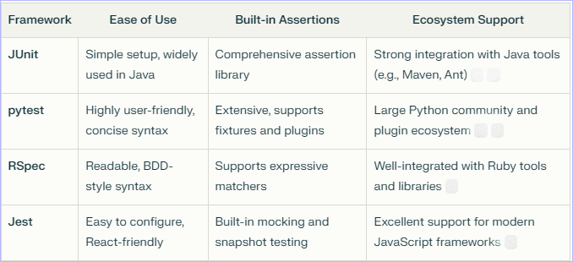
Key features
Here’s a comparison of ease of use, built-in assertions, and ecosystem support for popular unit testing frameworks:

Slide 13


Take A 5-Minute Break!
Stretch and relax
Hydrate
Clear your mind
Be back in 5 minutes

Slide 14
Discuss factors to consider when selecting a framework
| DevOps and Cloud Computing

Slide 15
Factors
When selecting a unit testing framework, consider the following key factors:
Language Compatibility: Ensure the framework supports the programming language of your project. For example, JUnit is ideal for Java, pytest for Python, and Jest for JavaScript.
Ease of Writing and Maintaining Tests: Look for frameworks with simple syntax, robust documentation, and features like built-in assertions or mocking.
Integration with CI/CD Pipelines: Choose a framework that integrates seamlessly with CI/CD tools to enable automated testing as part of the development lifecycle. Popular frameworks like JUnit and Jest offer strong CI/CD support.

Slide 16
Case studies of projects and suitable testing frameworks
| DevOps and Cloud Computing

Slide 17
Case studies
Here are case studies of projects and suitable testing frameworks based on their requirements:
1. E-commerce Web Application (Java)
Scenario: Testing payment processing and cart functionality
Framework: JUnit is ideal due to its seamless integration with Java, support for parameterized tests, and compatibility with CI/CD pipelines like Jenkins.
2. Data Analysis Tool (Python)
Scenario: Validating data processing algorithms for edge cases.
Framework: pytest is recommended for its powerful fixtures, parallel test execution, and concise syntax, making it efficient for large datasets.

Slide 18
3. Social Media Platform (Ruby)
Scenario: Ensuring user interactions (likes, comments) work as expected.
Framework: RSpec is suitable because of its BDD-style syntax, which makes tests readable and easy to maintain.
4. Single Page Application (JavaScript)
Scenario: Testing React components and user interactions.
Framework: Jest is the best choice due to its built-in mocking, snapshot testing, and excellent support for modern JavaScript frameworks.
5. Enterprise Software (C#)
Scenario: Testing business logic in a .NET application.
Framework: NUnit is ideal for its parallel execution capabilities, powerful assertions, and compatibility with .NET platforms.

Slide 19
Select a framework (e.g., pytest for Python or Jest for JavaScript)
| DevOps and Cloud Computing

Slide 20
Let’s see
Based on the query, pytest is an excellent choice for Python projects due to its powerful features and flexibility. Here's why:
Ease of Use: Pytest has a simple and concise syntax, making it beginner-friendly and efficient for writing and maintaining tests.
Advanced Features: It supports fixtures, parameterized testing, and assertion introspection, which streamline test organization and debugging.
Ecosystem Support: Pytest has a rich plugin architecture with over 1,300 plugins, allowing customization and integration with other tools, including CI/CD pipelines.
Scalability: It works well for both small unit tests and complex functional testing scenarios.

Slide 21
Demonstrate writing a simple unit test
| DevOps and Cloud Computing

Slide 22
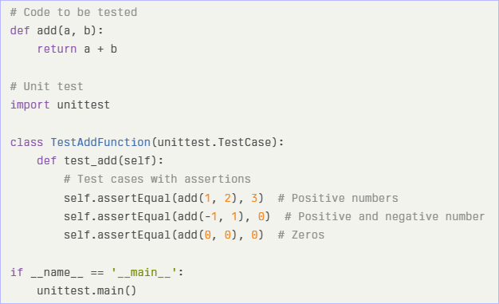
Let’s do it
Here’s a demonstration of writing a simple unit test in Python using the ‘unittest’ framework:
Code Example

Slide 23
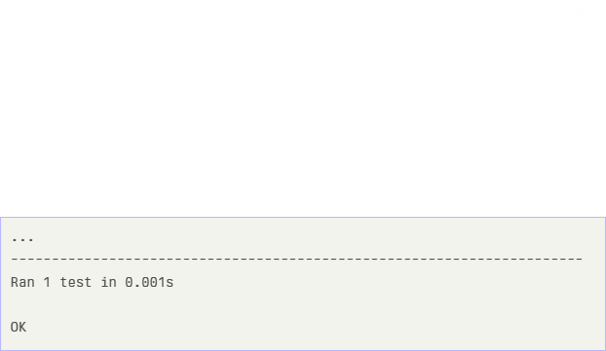
Steps:
Write the Function
Create Test Cases
Assertions
Run Tests
Output:

Slide 24
Time for case study!

Slide 25
Important
Complete the post-class assessment
Complete assignments (if any)
Practice the concepts and techniques taught in this session
Review your lecture notes
Note down questions and queries regarding this session and consult the teaching assistants

Slide 26
Thanks!

